Slide 1

Team Into Infinity (AICBI – CC09) Final project

Slide 2
Project Title Deploying static website on Cloud

Slide 3
Agenda
Problem Statement
Project Overview
END USERS
Solution and its value proposition
The WoW in the project
Modelling
Results
Meet Our Team

Slide 4

Problem Statement
Deploying Static website on
cloud platforms

Slide 5

Project Overview
It is a static website made with HTML,CSS and JavaScript.
It is a simple game.
The game is between user and the computer.The computer randomly select a number from 1-100.
The user have to guess the number until it matches with the computer number.
The user win if they guess the number.

Slide 6

Everyone like the games, so end users of our project is People not limited any age group. Anyone can play.
End Users

Slide 7

Solution
Now - a - days , Everyone feeling stress because of their Jobs (or) something else. They can feel happy while playing games. By playing games they can improved their mood, reduced emotional disturbance, relaxation and Stress reduction

Slide 8
The WoW in the project
It is well designed and friendly-user interface.
How to play the game is mentioned clearly.
The user feel relaxed while playing the game.
Thinking capability of the user will increase

Slide 9

Modelling
Start
Generated code
User
Guess
False
True
End

Slide 10

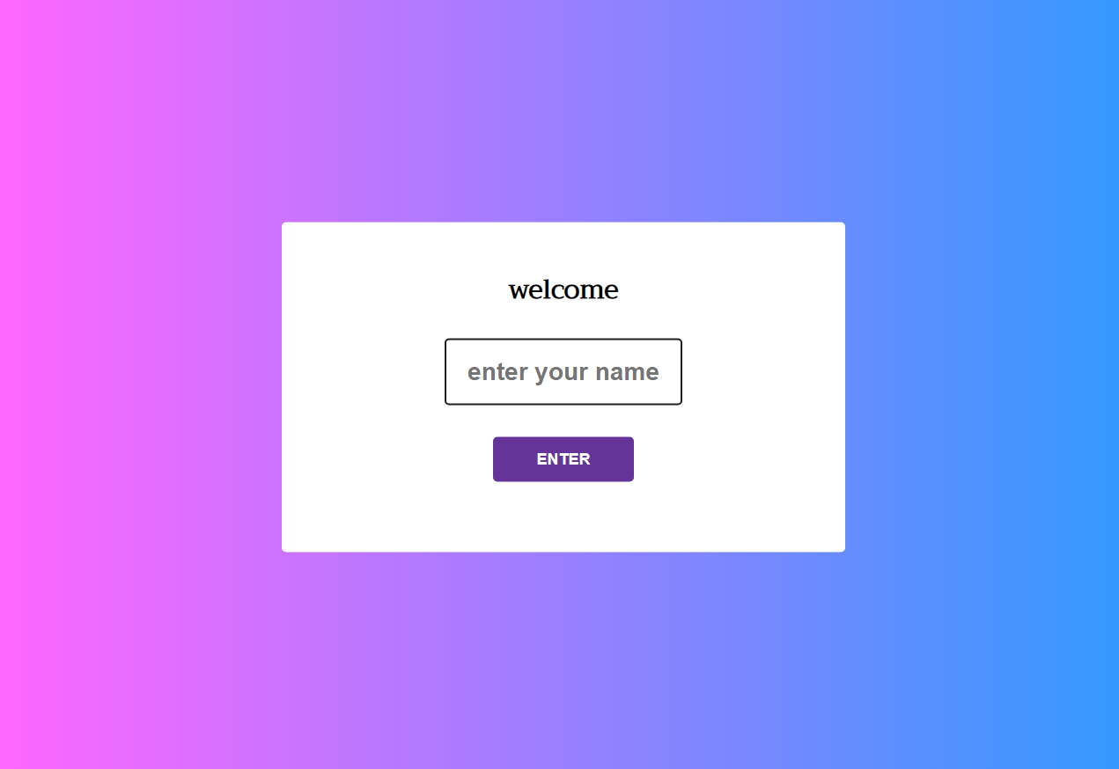
Results

Slide 11
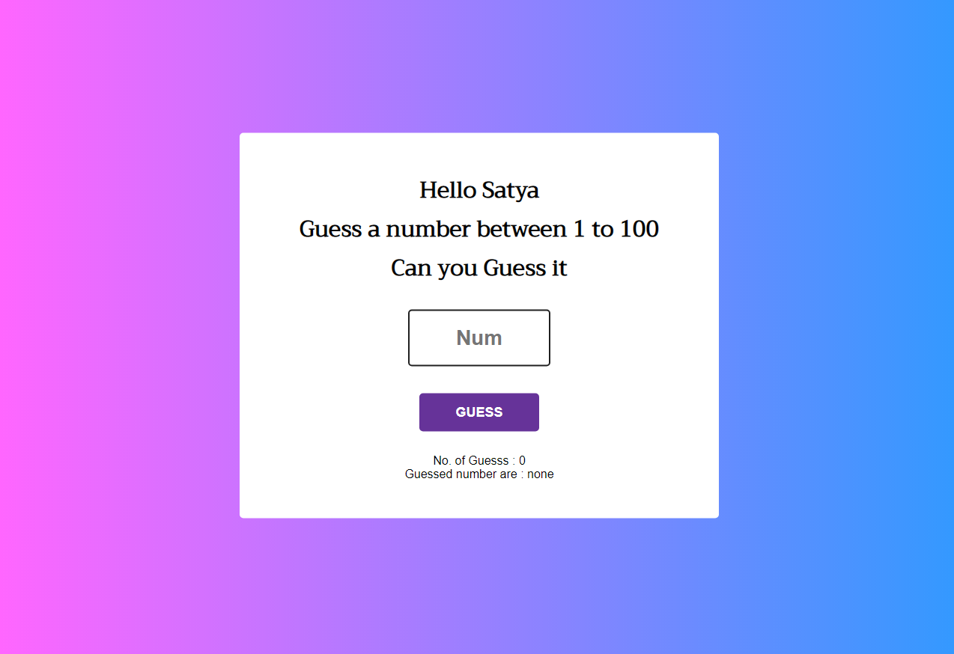
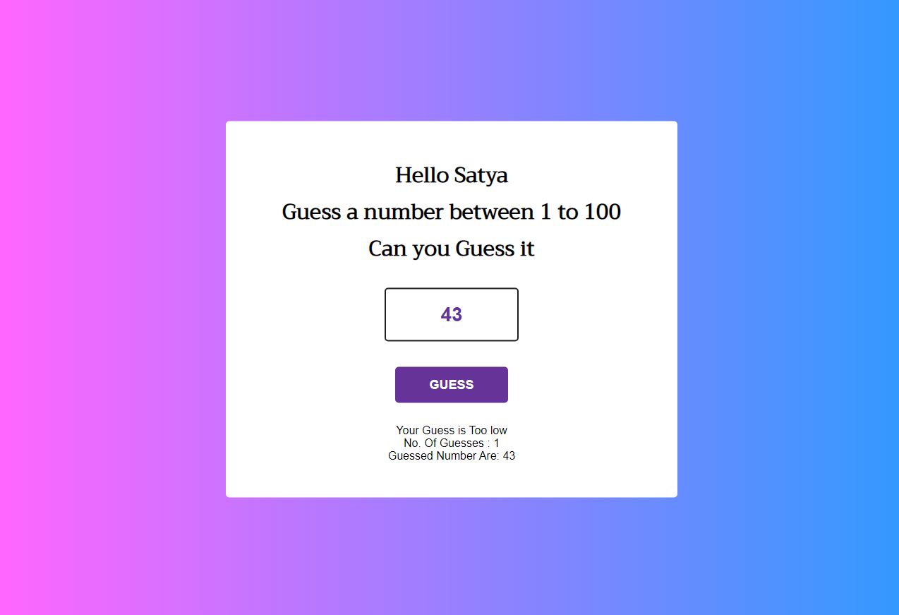
Results

Slide 12
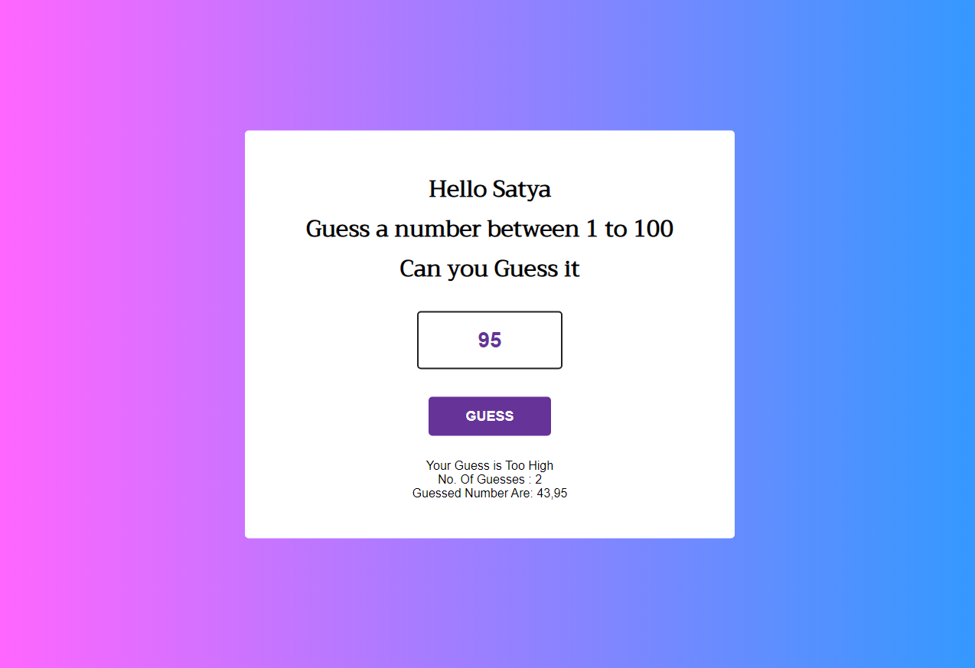
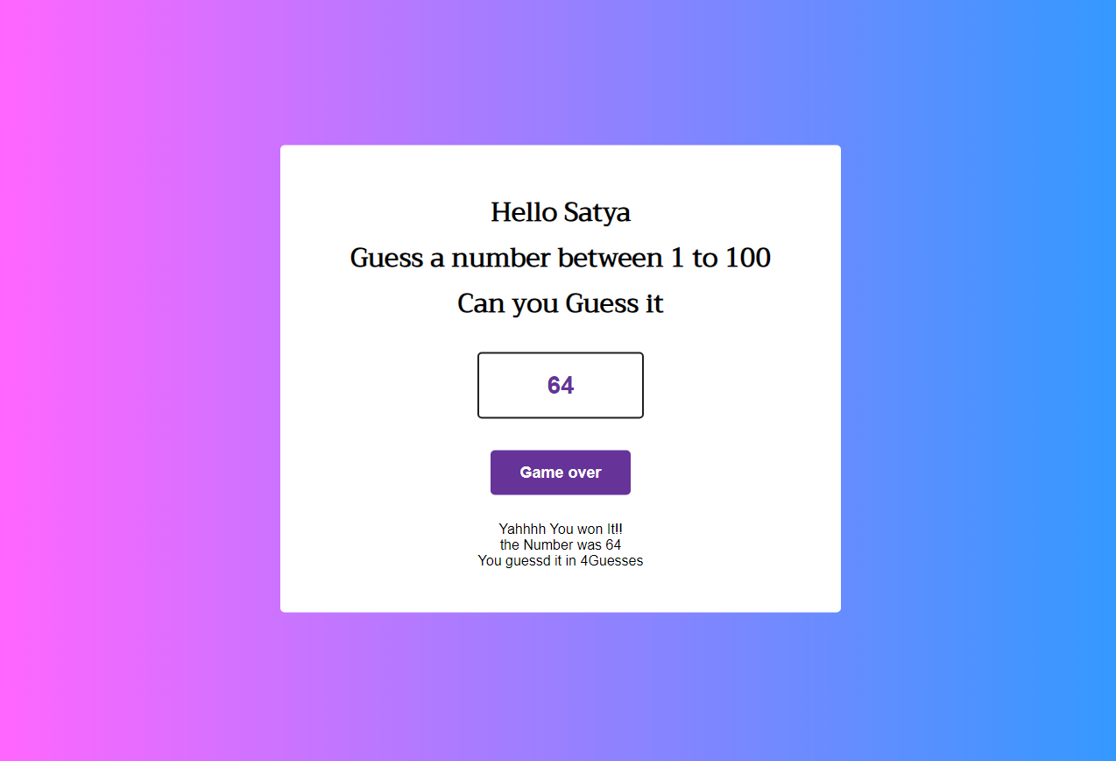
Results

Slide 13

Meet Our Team
1. M.Satyavathi
2. Sanjeev kumar
3. Priyansh
4. Vaibhav Pratap singh
5. Anjali singh
6. Gynandra Sahoo

Slide 14
Thank You

